Slide 1

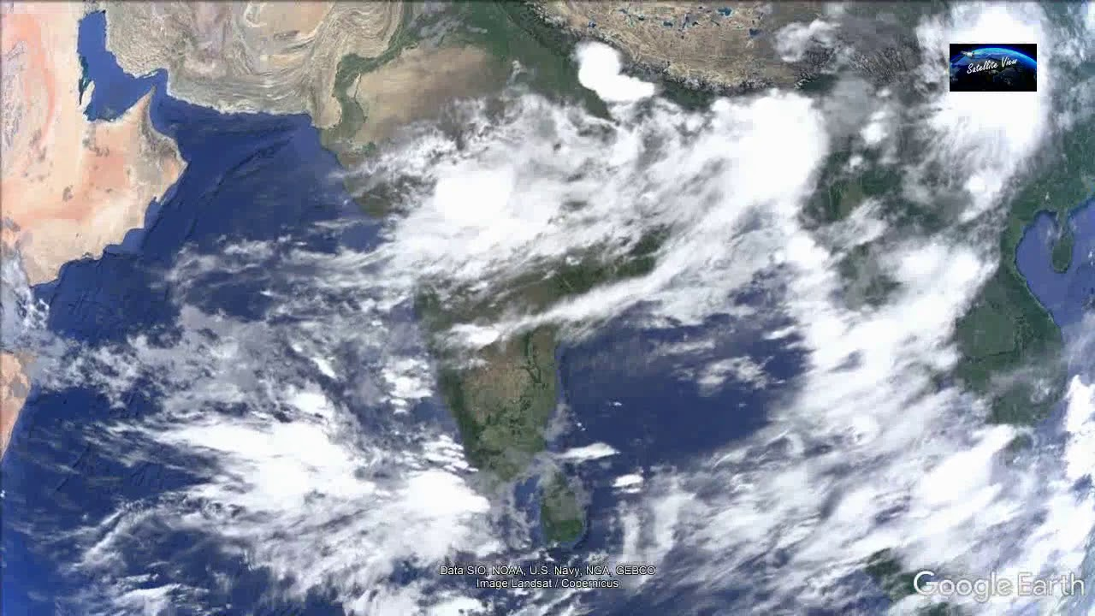
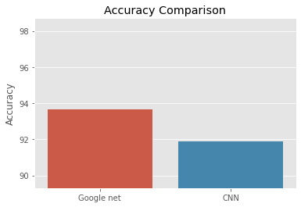
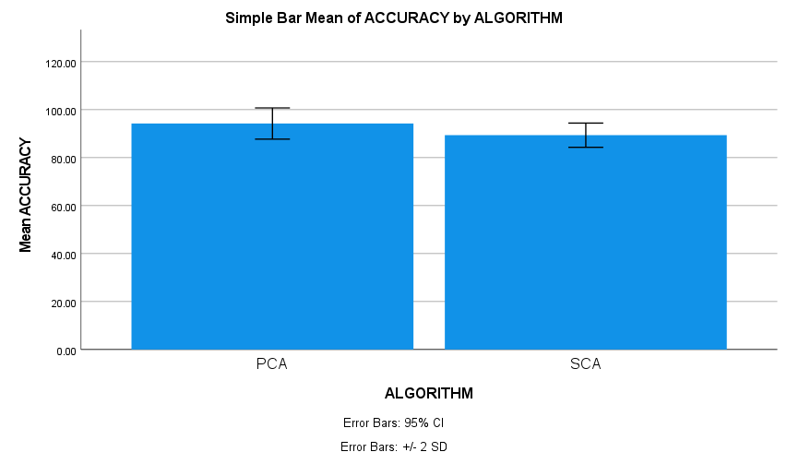
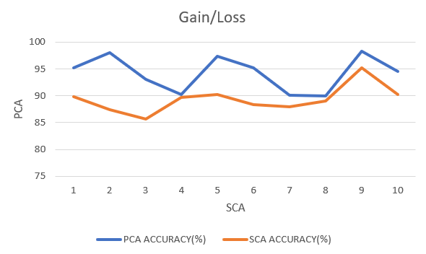
Name: Revanth Alli Register Number: 192110492
Guided by: Dr. T. P. Anithaashri
Ms. Poorani.S
Guided by Dr. Mary Valantina. G
Accuracy Analysis of Principal Component Analysis Algorithm over Seam Craving Algorithm in Celestial Cloudscapes Through Picpluse Magic.
INTRODUCTION
Evaluate the accuracy of Principal Component Analysis (PCA) against Seam Carving Algorithm in analyzing celestial cloudscapes through Picpluse Magic for enhanced understanding and interpretation.
Assessing the accuracy of PCA and Seam Carving Algorithm aids in refining celestial cloud analysis methods, crucial for dimension reduction in clouds images.
Findings contribute to advancing celestial cloud analysis techniques, benefiting meteorological agencies, environmental researchers, and astronomers for improved decision-making and space issues, thereby bridging critical research gaps.
PCA focuses on dimensionality reduction and Seam craving removes non-essential content from the clouds data sets.
Celestial cloudscapes obtained through Picpluse Magic serve as the dataset for comparative analysis, facilitating evaluation of PCA and Seam Carving Algorithm accuracy.
Indian Satellite view of clouds
MATERIALS AND METHODS
Data collection
Processing Steps
1. PCA Algorithm
2. Seam Carving Algo
Output
Comparative insights on algorithm accuracy
Pre processing
Comparative Analysis Evaluation of PCA vs. Seam Carving Accuracy
Accuracy
94.20%
RESULTS
Algorithm | N | Mean | std.deviation | Std.error mean
Accuracy Principal component analysis algorithm Seam craving Algorithm | 10 10 | 94.2020 89.3530 | 3.25330 2.52153 | 1.02878 .79738
PCA and SCA
Statistical Analysis values
Gain/Loss of PCA and SCA
This paper compares the Seam Craving Algorithm (SCA) with Principal Component Analysis (PCA). The results show that the PCA method is more accurate 94.20% Than the SCA algorithm, which yields 89.35%.
The principal component analysis Algorithm and the Seam craving Algorithm have the values of the Mean accuracy, Standard Deviation, and Standard Error .
DISCUSSION AND CONCLUSION
The findings of the investigation show that the Principal Component Analysis algorithm performed better than the Seam Craving Algorithm, with a high accuracy of 94.20%.
The significance value p=0.016 (p<0.05) of the independent sample t-test indicates a significant difference in the algorithms among the 450 total sample.
The Principal Component Analysis algorithm (PCA) outperforms the other approach by 94.20% in terms of accuracy.
Through this exploration, it is deduced that Principal Component Analysis (PCA) algorithm has elevated precision comparing with Seam Craving algorithm for compelling examination on size decrease of images.
Similar findings have been reported regarding Picpluse Magic's comparison of the Principal Component Analysis (PCA) algorithm and the Seam Carving algorithm in cosmic cloudscapes.
BIBLIOGRAPHY
Russ, John C., and F. Brent Neal. 2018. The Image Processing Handbook. CRC Press.
Masunaga, Hirohiko. 2022. Satellite Measurements of Clouds and Precipitation: Theoretical Basis. Springer Nature.
Waggoner, Philip D. 2021. Modern Dimension Reduction. Cambridge University Press.
Esmaili, Rebekah Bradley, Yudong Tian, Daniel Alejandro Vila, and Kyu-Myong Kim. 2016. “A Lagrangian Analysis of Cold Cloud Clusters and Their Life Cycles with Satellite Observations.” Journal of Geophysical Research, D: Atmospheres 121 (19): 11723–38.
Antar, Samar, Hussein Karam Hussein Abd El-Sattar, Mohammad H. Abdel-Rahman, and Fayed F M Ghaleb. 2023. “COVID-19 Infection Segmentation Using Hybrid Deep Learning and Image Processing Techniques.” Scientific Reports 13 (1): 22737.*

